Slide 1

Dell Technologies - recognized as one of the World’s Most Ethical Companies five years in a row
https://www.3gi.co.za/why-dell-technologies-is-the-worlds-most-ethical-company/

Slide 2
Dell promises or has achieved :
To reduce ALL plastic waste by 2020
95% less water used by high tech vertical farms
$30 million donated to pediatric cancer treatments
Reduced energy in their products by 65% since 2011
ReStart Program helps women get back into their career.
Goal of using digital technologies to provide better outcomes and experiences for their customers
Strict environmental, worker and business policies

Slide 3
Dell - Social Impact Plan and Goals for 2030
100% of packaging made from recycled or renewable material.
Over half of product content to be made from recycled or renewable material.
Greenhouse gas emissions reduced by 50%
75% of electricity from renewable sources across all Dell Technologies facilities.
We will reduce the energy intensity of our entire product portfolio by 80%
We will partner with our direct material suppliers to meet a science-based greenhouse gas emissions reduction target of 60% per unit revenue by 2030
25% of our U.S. workforce and 15% of our U.S. leaders will be Black/African American and Hispanic/Latino.
50% of the people empowered by our social and education initiatives will be girls, women or underrepresented groups.
75% of our employees will participate in giving or volunteerism in their communities

Slide 4
At Dell Technologies, we believe that diversity is power
It’s how we win and win the right way. We are experiencing a time when our commitment to diversity and inclusion has never been more important.
The disproportionate impacts of COVID-19 and longstanding racial injustice have highlighted the need to address socioeconomic disparity and continue to work towards racial equity.

Slide 5
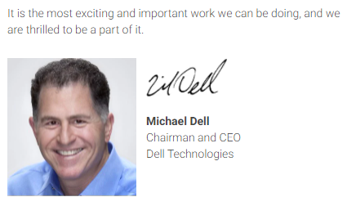

Slide 6
DISCUSSION: What is the difference in ethical approach shown by Dell compared to the Cruise line industry? Why the big difference in ethical approach between DELL and the Cruise line industry?... How do the social impact goals of DELL compare to those of the Australian Government ?

